Slide 1
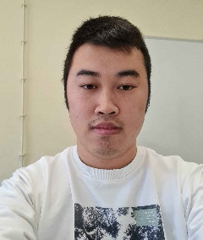
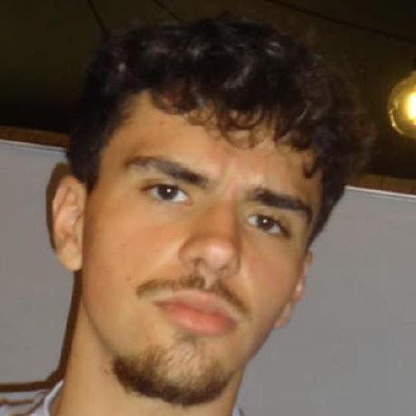

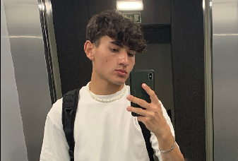
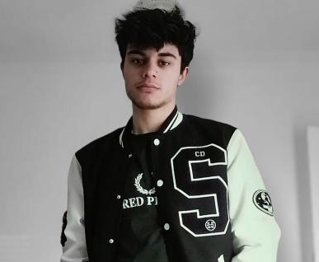
Class 2Dx2DM Group 131 SPRINT 1
LAPR3 2024_2025
Group members:
Romeu Xu (1230444) | Francisco Santos (1230564) | Emanuel Almeida (1230839) | Jorge Rodriguez (1231274) | Paulo Mendes (1231498)

Slide 2
Sprint planning – Sprint 1
Planned Start Date: 30/09/2024 Real Start Date: 3/10/2024
Planned Finished Date: 23/10/2024 Real Finish Date: 26/10/2024
SPRINT BACKLOG
Number of stories | 19
Number of bugs | 3
Number of tasks | 26
Number of Management Tasks (Scrum) | 16
Number of team members | Planned: 5 Actual: 5
Total planned estimation vs execution | Planned hours: 122 Executed hours: 140

Slide 3
Sprint planning BDDAD
Assignment US (as stated on project assignment) | Commited? (Yes / no according to team planning) | Todo | Doing | Testing | Done | Blocked
USEI 01 | Yes |  |  |  | x
USEI 02 | Yes |  |  |  | x
USEI 03 | Yes |  |  |  | x
USEI 04 | Yes |  |  |  | x
USEI 05 | Yes |  |  |  | x
USEI 06 | Yes |  |  |  | x
USEI 07 | Yes |  |  |  | x
USEI 08 | Yes |  |  |  | x
USEI 09 | Yes |  |  |  | x

Slide 4
Sprint planning ESINF
Assignment US (as stated on project assignment) | Commited? (Yes / no according to team planning) | Todo | Doing | Testing | Done | Blocked
USEI 01 | Yes |  |  |  | x
USEI 02 | Yes |  |  |  | x
USEI 03 | Yes |  |  |  | x
USEI 04 | Yes |  |  |  | x
USEI 05 | Yes |  |  |  | x
USEI 06 | Yes |  |  |  | x
USEI 07 | Yes |  |  |  | x

Slide 5
Sprint planning LAPR3
Assignment US (as stated on project assignment) | Commited? (Yes / no according to team planning) | Todo | Doing | Testing | Done | Blocked
USEI 01 | Yes |  |  |  | x
USEI 02 | Yes |  |  |  | x
USEI 03 | Yes |  |  |  | x | x

Slide 6
Work by team member

Slide 7
Work by type

Slide 8
Issues / Assumptions / unanswered questions
Description | Responsible | Date / sprint | Related issue / item in Git
There was a problem with the dataset, it came way later than expected, and it created some organization issues, and it was altered twice. | BD Prof | Sprint 1
It was assumed that each time unit was considered a while loop. | 1231274 | Sprint 1
The lack of starting information, the template for this project was based on a previous one. | ESINF | Sprint1

Slide 9
Daily Meetings
Date | Place / duration | Team member 1 | Team member 2 | Team member 3 | Team member 4 | Team member 5
30/09/2024 | Class / 15 min | x | x | x | x | x
02/10/2024 | Class / 15 min | x | x | x | x | x
04/10/2024 | Class / 15 min | x | x | x | x | x
06/10/2024 | Class / 15 min | x | x | x | x | x
08/10/2024 | Class / 15 min | x | x | x | x | x
10/10/2024 | Class / 15 min | x | x | x | x | x
12/10/2024 | Class / 15 min | x | x | x | x | x
14/10/2024 | Class / 15 min | x | x | x | x | x
16/10/2024 | Class / 15 min | x | x | x | x | x
18/10/2024 | Class / 15 min | x | x | x | x | x
20/10/2024 | Class / 15 min | x | x | x | x | x

Slide 10

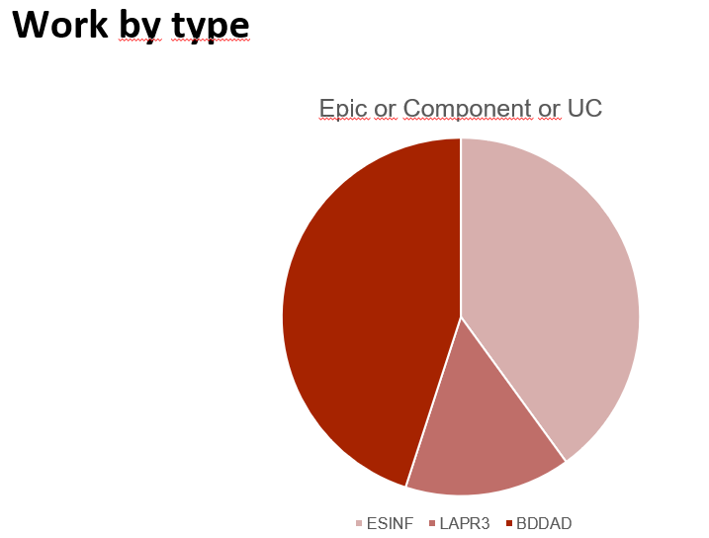
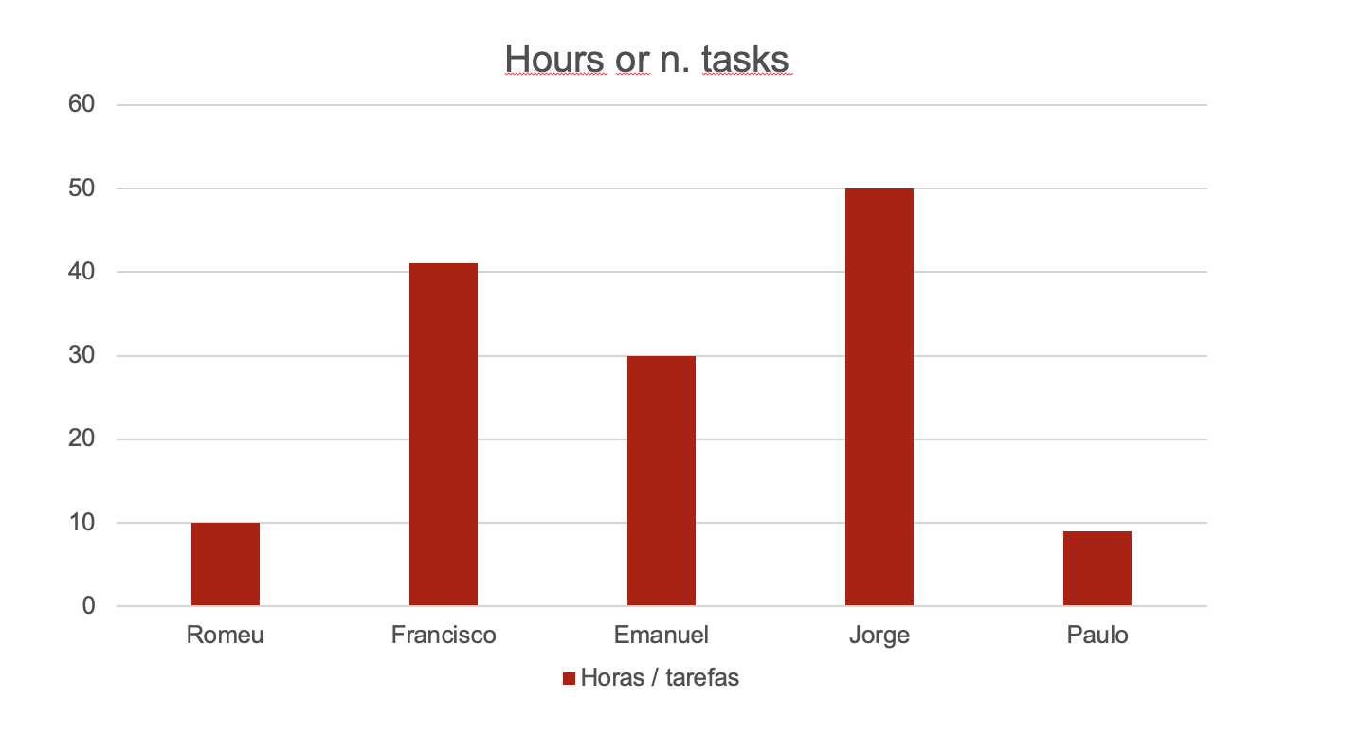
LLM performance assessment (chatGPT or Copilot)
Source file (include file as attachment):
Input (prompt) : make a performance assessment based on these 2 images
make a performance assessment based on these 2 images
Make a performance assessment based on these 2 images. make a performance assessment based on these 2 images

Slide 11
LLM performance assessment
Output file (include file as attachment):
Output (one line per team member):
“Jorge has the highest contribution, with about 50 hours completed. This indicates that Jorge is currently leading in productivity, possibly carrying a larger workload.
Francisco is the second most productive, contributing around 41 hours.
Emanuel comes close to Francisco with a lower contribution, likely around 30 hours.
Romeu and Paulo have the lowest contributions, with Romeu with 10 and Paulo below 10. “
Opinion about the output:
The data reflects a diverse range of contributions among the team members, highlighting both strengths and areas for potential growth. Jorge leads with an impressive contribution of around 50 hours, showcasing his strong commitment and productivity. This level of engagement is commendable, and it’s important for the team to ensure that his workload remains manageable to maintain his well-being.
Francisco’s contribution of about 41 hours demonstrates a solid work ethic, positioning him as a key contributor alongside Jorge. Emanuel’s input of around 30 hours is also noteworthy and indicates that he is actively engaged in supporting team objectives.
While Romeu and Paulo have lower contributions, with Romeu around 10 hours and Paulo below that.

Slide 12
Sprint Retrospective
Date: 27/10/2024
What went well?
Overall the team was very helpful to each member.
The team was never late.
Participated in a lot of meeting.
What went wrong?
Late introduction of the data base needed for the project.
What we’ve learned?
Leaned a lot about new information structures like map and queues.
We applied DDL and DML.
Learned new concepts about Production Management and Product Engineering

Slide 13
Sprint Retrospective
Date: 27/10/2024
Action items:
Balance Workload Across Team Members
Provide Support for Underperforming Team Members
Focus on High-Priority Projects
Improve Time Management and Prioritization

Slide 14


Overall Project perfomance:
Comments: Overall the team performed as expected, all the issues were quickly resolved and everyone contributed for the completion of the project.
- LLM evaluation:

Slide 15


